Slide 1

An Instructor’s Outline of
Designing the User Interface
4th Edition
by Ben Shneiderman & Catherine Plaisant
Slides developed by Roger J. Chapman

Slide 2

Chapter 5
Software Tools

Slide 3
Specification Methods
Design requires a good notation to record and discuss alternate possibilities:
  The default language for specifications in any field is natural language, e.g., English
  Communication medium, e.g., sketchpad, or blackboard
Natural-language specifications tend to be:
  lengthy
  vague
  ambiguous
Therefore often are difficult to prove:
  correct
  consistent
  complete

Slide 4
Specification Methods (cont.)
Backus-Naur Form (a.k.a. Backus Normal Form or BNF)
  high-level components are described as nonterminals
  specific strings are described as terminals
Grammars Example
<Telephone book entry>::= <Name><Telephone number>
<Name> ::= <Last name>, <First name>
<Last name> ::= <string>
<First name> ::= <string>
<string> ::= <character>|<character><string>
<character> ::= A|B|C|D|E|F|G|H|I|J|K|L|M|N|O|P|Q|R|S|T|U|V|W|X|Y|Z
<Telephone number>::= (<area code>) <exchange>-<local number>
<area code>::= <digit><digit><digit>
<exchange>::= <digit><digit><digit>
<local number>::= <digit><digit><digit><digit><digit>::= 0|1|2|3|4|5|6|7|8|9

Slide 5
Specification Methods (cont.)
Examples of acceptable entries
  WASHINGTON, GEORGE (301) 555-1234
  BEEF, STU (726) 768-7878
  A, Z (999) 111-1111
Multiparty grammars
  <Session> ::= <U: Opening> <C: Responding>
  <U: Opening> ::= LOGIN <U: Name>
  <U: Name> ::= <U: string>
  <C: Responding> ::= HELLO [<U: Name.]
  U: User C: Computer
Multiparty grammars are effective for text oriented command sequences

Slide 6
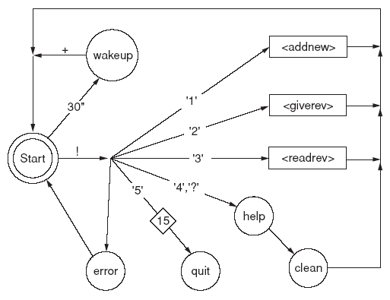
Specification Methods (cont.)
Transition Diagram
  a set of nodes that represents system states and a set of links between the nodes that represents possible transitions

Slide 7
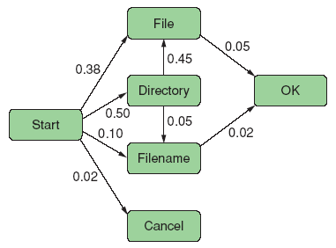
Specification Methods (cont.)

Slide 8
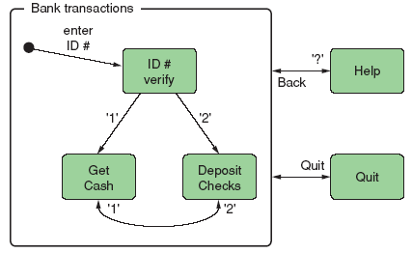
Specification Methods (cont.)
State Charts

Slide 9
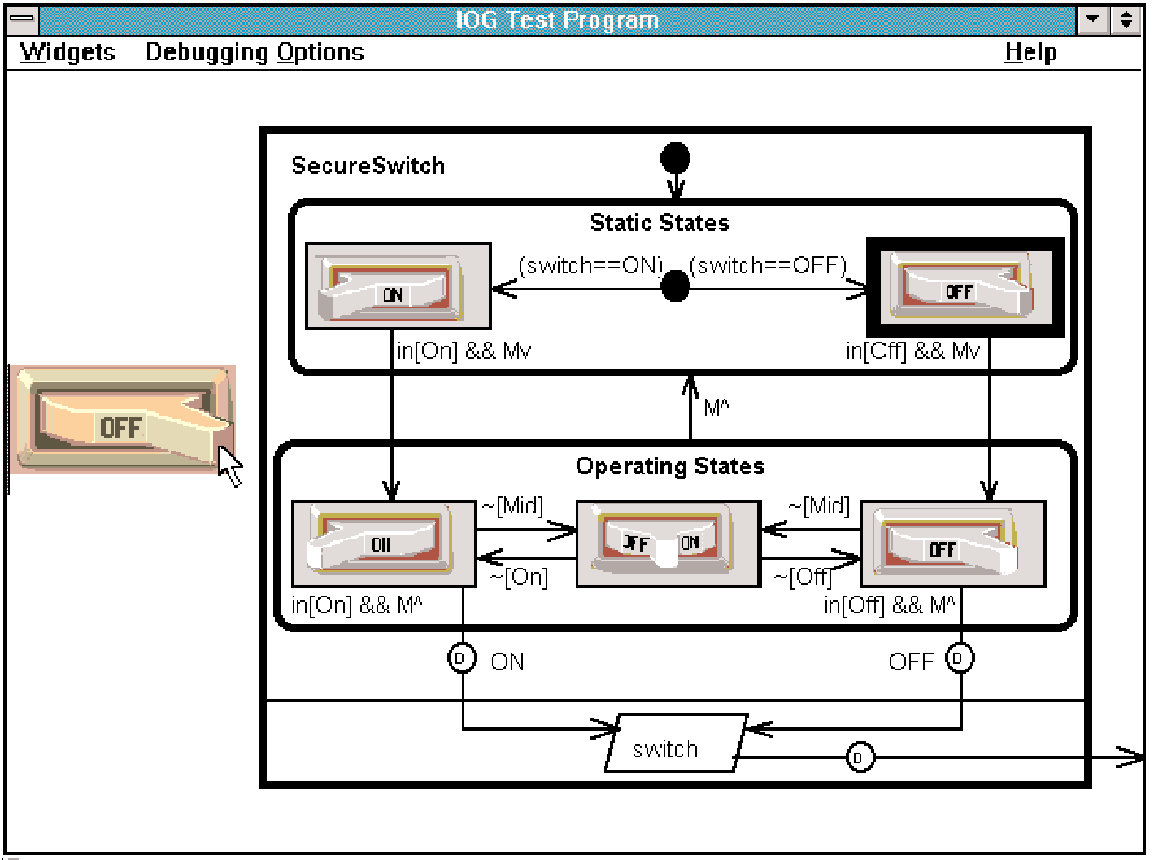
Specification Methods (cont.)

Slide 10
Interface-Building Tools
Features of Interface-Building Tools.
User Interface Independence
  Separate interface design from internals
  Enable multiple user interface strategies
  Enable multiple platform support
  Establish user interface architect role
  Enforce standards
Methodology & Notation
  Develop design procedures
  Find ways to talk about design
  Create project management

Slide 11
Interface-Building Tools (cont.)
Rapid Prototyping
  Try out ideas very early
  Test, revise, test, revise,...
  Engage end users, managers, and others
Software Support
  Increase productivity
  Offer some constraint & consistency checks
  Facilitate team approaches
  Ease maintenance

Slide 12
Interface-Building Tools (cont.)
User interface mockup tools
Examples
  Paper and pencil
  Word processors
  Slide-show software
  Macromedia Director, Flash mx, or Dreamweaver
Visual Editing
  Microsoft Visual Studio
  Borland JBuilder

Slide 13
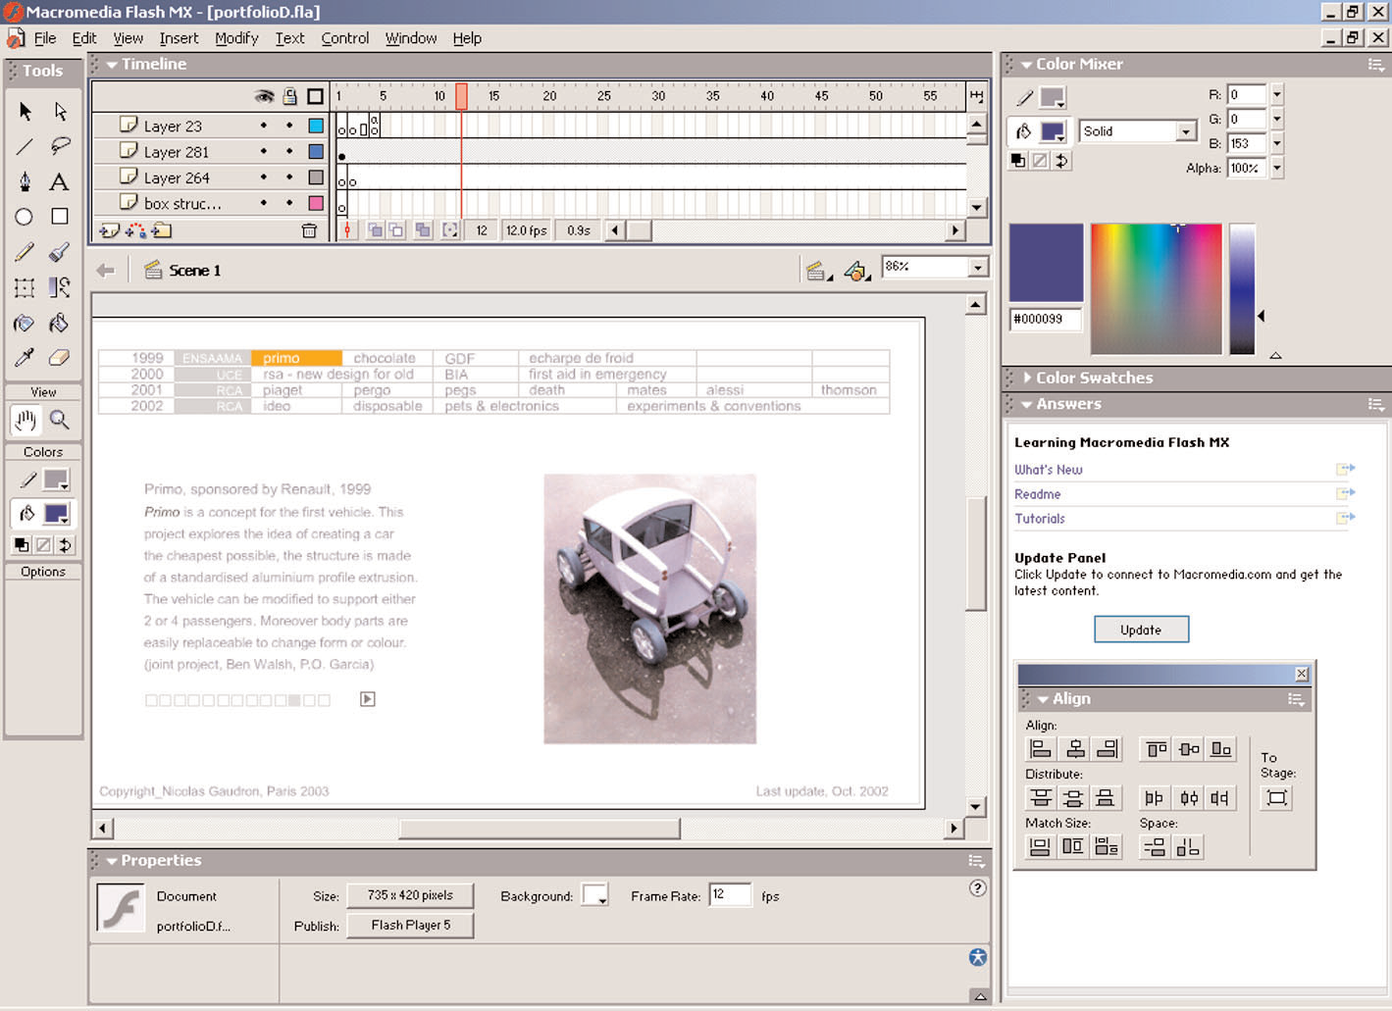
Interface-Building Tools (cont.)

Slide 14
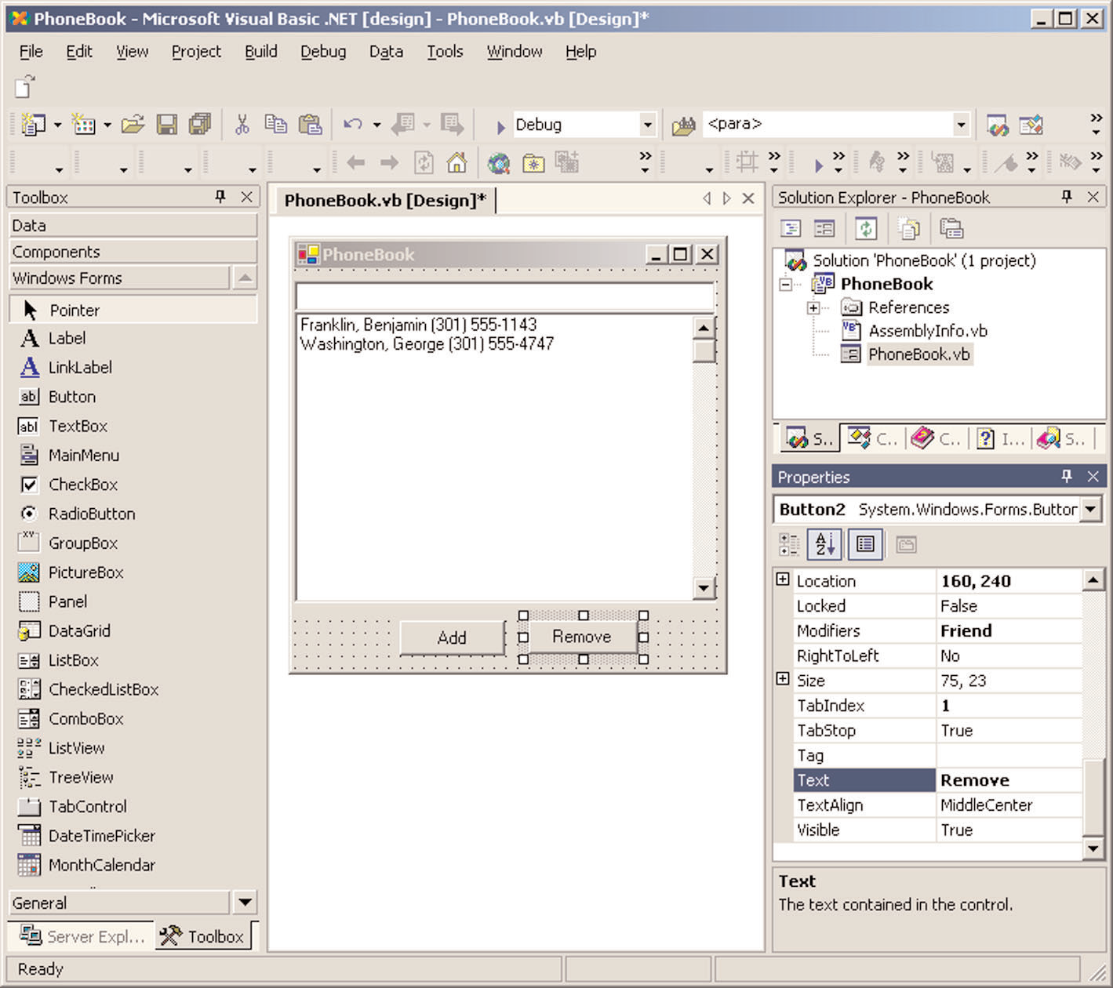
Interface-Building Tools (cont.)

Slide 15
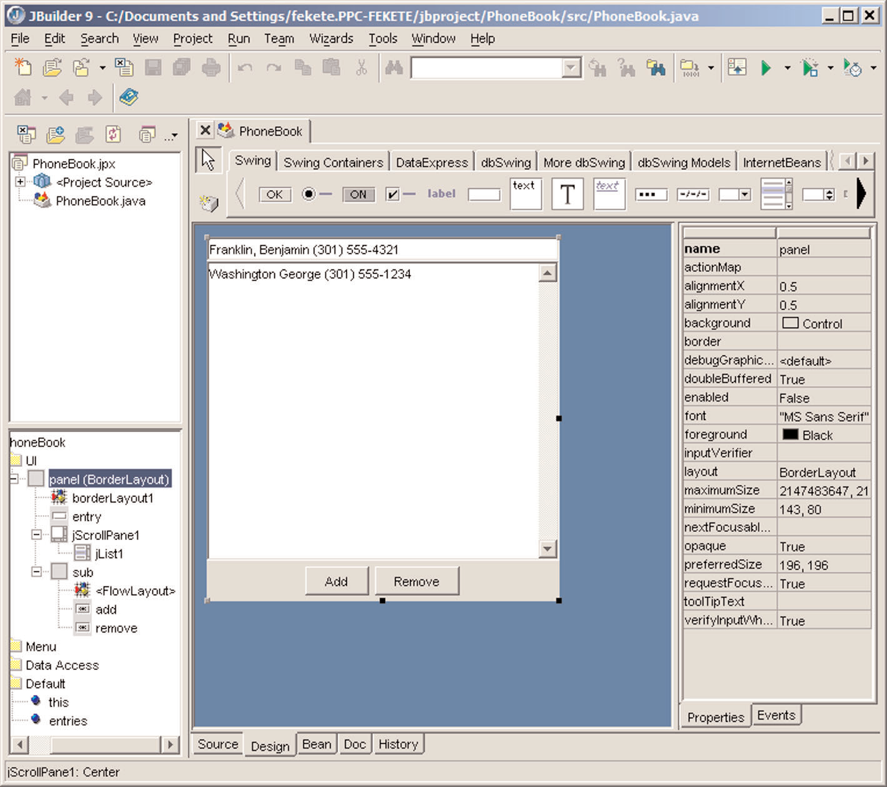
Interface-Building Tools (cont.)

Slide 16
Interface-Building Tools (cont.)
Finding the right tool is a tradeoff between six main criteria:
  Part of the application built using the tool.
  Learning time
  Building time
  Methodology imposed or advised
  Communication with other subsystems
  Extensibility and modularity

Slide 17
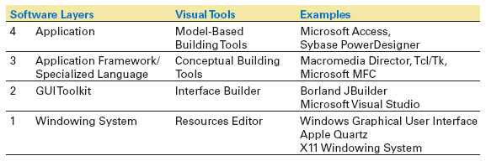
Interface-Building Tools (cont.)

Slide 18
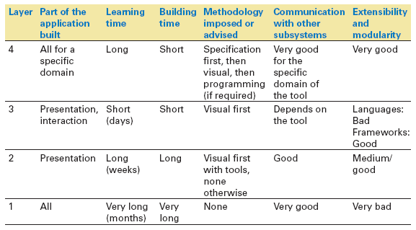
Interface-Building Tools (cont.)

Slide 19
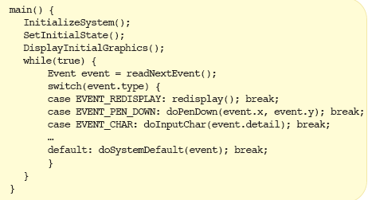
Interface-Building Tools (cont.)
The windowing system layer
  Sometimes working at a low-level is required.
  E.g., new platform
  The while(true) main loop

Slide 20
Interface-Building Tools (cont.)
The GUI toolkit layer
  Widgets, such as windows, scroll bars, pull-down or pop-up menu, etc.
  Difficult to use without an interface

Slide 21
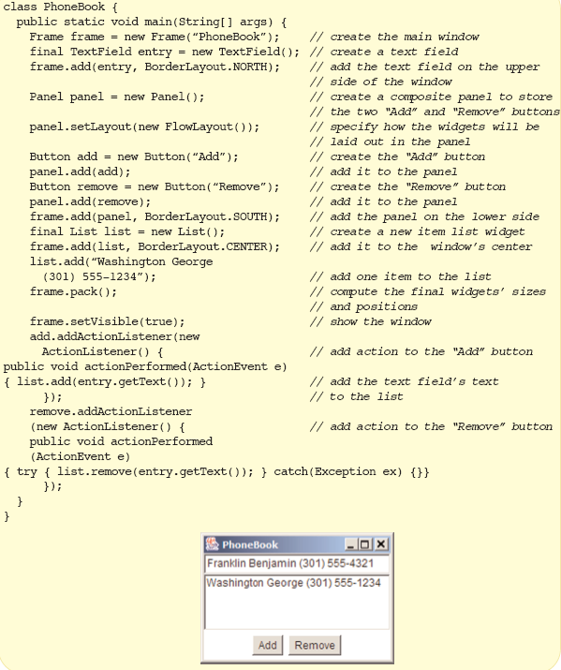
Interface-Building Tools (cont.)

Slide 22
Interface-Building Tools (cont.)
The application framework and specialized language layer
  Application frameworks are based on object-oriented programming
      Can quickly build sophisticated interfaces
      Require intensive learning
  Specialized language layers lighten the programming burden
      Tcl (and its toolkit Tk)
      Perl/Tk
      Python/Tk
      Visual Basic
      Java Script

Slide 23
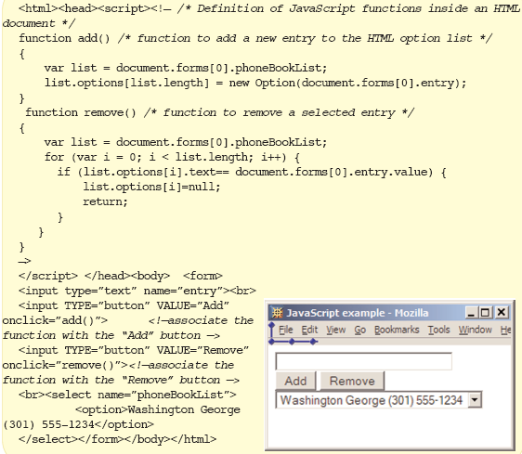
Interface-Building Tools (cont.)

Slide 24
Evaluation and Critiquing Tools
Tullis' Display Analysis Program, Version 4.0:
Takes alphanumeric screen designs and produces display-complexity metrics plus some advice:
  Upper-case letters: 77% The percentage of upper-case letters is high.
    Consider using more lower-case letters, since text printed in normal upper- and lower-case letters is read about 13% faster than text in all upper case. Reserve all upper-case for items that need to attract attention.

Slide 25
Evaluation and Critiquing Tools (cont.)
  Maximum local density = 89.9% at row 9, column 8.
  Average local density = 67.0%
    The area with the highest local density is identified...you can
    reduce local density by distributing the characters as evenly as feasible over the entire screen.
  Total layout complexity = 8.02 bits
  Layout complexity is high.
    This means that the display items (labels and data) are not well aligned with each other...Horizontal complexity can be reduced by starting items in fewer different columns on the screen (that is, by aligning them vertically).

Slide 26
Evaluation and Critiquing Tools (cont.)
Doctor HTML - Web Page Analyzer:
http://imagiware.com/RxHTML
  Did not find the required open and close HEAD tag. You should open and close the HEAD tag in order to get consistent performance on all browsers.
  Found extra close STRONG tags in the document. Please remove them.

